Slide 1
Spam or Not Spam Data Generation Using LSTM VAE

Slide 2
Introduction
This presentation explores the implementation of an LSTM-based Variational Autoencoder (VAE) model for generating synthetic data from the 'Spam or Not Spam' dataset sourced from Kaggle. It discusses the key methodologies, results, and potential applications of the model in enhancing spam detection.

Slide 3
Overview of Spam Detection
Spam detection is crucial in Natural Language Processing (NLP). Large datasets are essential for developing robust models. The 'Spam or Not Spam' dataset provides labeled email data but has limitations due to data scarcity.

Slide 4
Methodology
The study uses a Long Short-Term Memory (LSTM)-based VAE to generate additional data. Key components include text preprocessing, model training, and evaluation.

Slide 5
Dataset Overview
'Spam or Not Spam' dataset from Kaggle consists of labeled email texts. The dataset is critical for training spam detection models.

Slide 6
Preprocessing Techniques
Tokenization of words using TensorFlow’s tokenizer. Creation of a vocabulary list with a limit of 20,000 words. Conversion of text into numerical sequences padded to 200 tokens. Dataset split into 80% training and 20% testing subsets.

Slide 7
Model Architecture
The LSTM VAE model implemented in PyTorch includes: An encoder with LSTM layers to compress input text. A latent space representing Gaussian distribution. A decoder to reconstruct text data from latent space. Hyperparameters such as embedding dimension, latent dimension, and hidden units.

Slide 8
Synthetic Data Generation Process
Trained model generates synthetic spam and not spam text data. Sampling from latent space allows for new data point generation. Quality of synthetic samples is critical for diverse and realistic outputs.

Slide 9
Evaluation Metrics
Reconstruction accuracy is measured; high accuracy suggests effective pattern capture. KL divergence assesses Gaussian distribution learning in latent space. Results indicated a reconstruction loss of 94% and KL divergence of 0.0001.

Slide 10
Beta Annealing Technique
Incorporated to balance reconstruction loss and KL divergence. Gradually scales the KL divergence term during training. Aims to improve latent representation learning over epochs.

Slide 11
Discussion of Results
The model demonstrated capability in generating realistic data. High reconstruction accuracy could indicate potential overfitting. Low KL divergence suggests challenges in utilizing latent space. Impacts the ability to generate diverse samples.

Slide 12
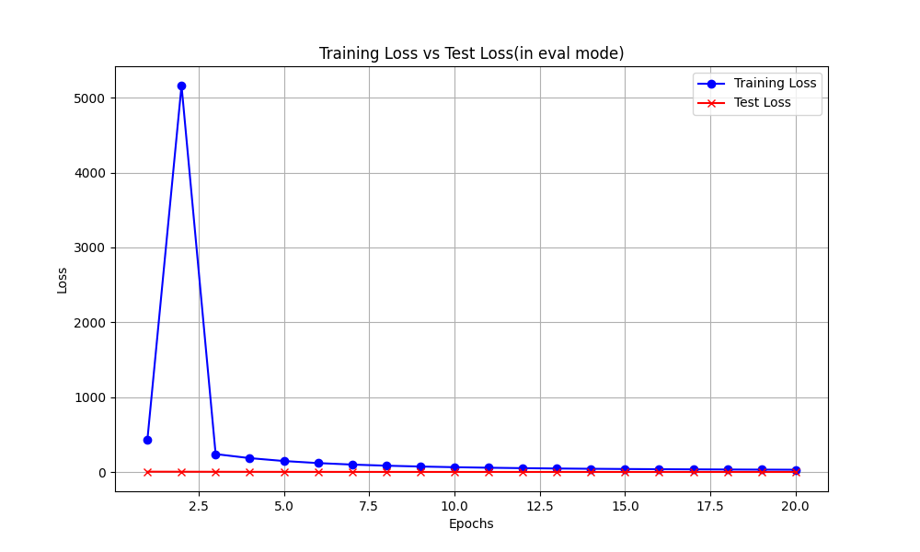
Loss plot

Slide 13
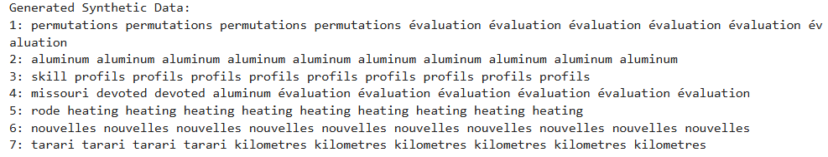
Generated data

Slide 14
Conclusion
The implementation of the LSTM VAE model shows promise in generating synthetic data for spam detection. While effective in capturing latent representations, challenges in diversity indicate areas for future improvement. This method can enhance datasets for better spam classification performance.

Slide 15
References
Kingma, D. P., & Welling, M. (2013). Auto-Encoding Variational Bayes. arXiv preprint arXiv:1312.6114.
Hakan, O. (2020). Spam or Not Spam Dataset. Kaggle. Retrieved from https://www.kaggle.com

